Slide 1

IMAGE MANIPULATION DETECTION USING CNN
Presented By :
Vaibhav Magar (Roll No : 43 )
Anuja Pitrubhakt (Roll No : 61)
Pranav Shelke (Roll No : 69 )
Shubham Shinde (Roll No : 73)

Slide 2
Problem Definition
In today’s world several image manipulation software's are available. Manipulation of digital images has become a serious problem.
There are many areas like medical imaging, digital forensics, journalism, etc. where image manipulation can be done very easily.
To find the marks of tampering in a digital image is a challenging task.
In order to solve this problem, an algorithm for the detection of splicing and copy-move image manipulation in the same instance is introduced.
This detection technique is proposed to exploits the artifacts originated due to manipulations performed on JPEG images.

Slide 3
Scope and Objectives
Scope :
To detect the image manipulation on JPEG images.
Objectives :
To detect whether the image is manipulated or not.
To identify the manipulated area in image.

Slide 4
Requirement Specification
Software Requirements :
Pycharm
Jupyter Notebook

Slide 5
Literature Review
Sr. No | Paper Title | Author | Abstract
1. | Image Manipulation Detection using Deep Neural Network - | Anushka Singh, Jyotsna Singh | Relative analysis includes different deep learning techniques used for image forgery detection. The approaches used are the simplest and independent of dataset.
2. | Image Manipulation Detection using Convolutional Neural Network - | Dong-Hyun Kim & Hae-Yeoun Lee | Image manipulation detection techniques using CNN.The model can be used to determine whether or not the image is manipulated, and can be applied for detection of more manipulation techniques.
3. | Image Forgery Detection based on statistical features of block DCT coefficients - | Shilpa Dua, Harish Parthasarathy | Research presented a new forensic detector which is able to deal with splicing as well as copy-move forgery at the same time.This method not only classifies unaltered images from altered ones, but also capable of dealing correctly with any kind of manipulation.

Slide 6




Experimental Setup / Simulation
Block Diagram
User
Input Image
Preprocessing
Display Result
Identification of tampered area using ELA (Error Level Analysis)
CNN (Convolutional Neural Network)

Slide 7
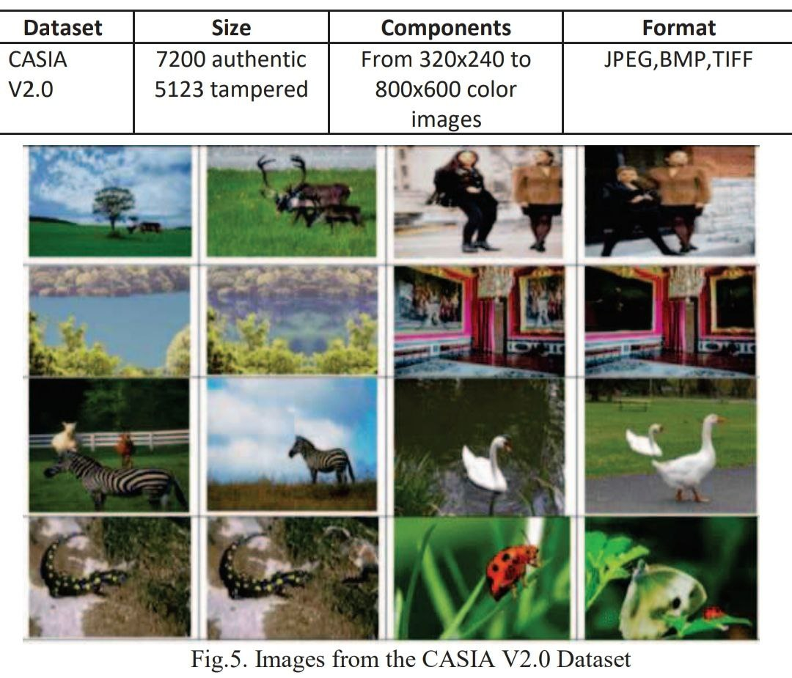
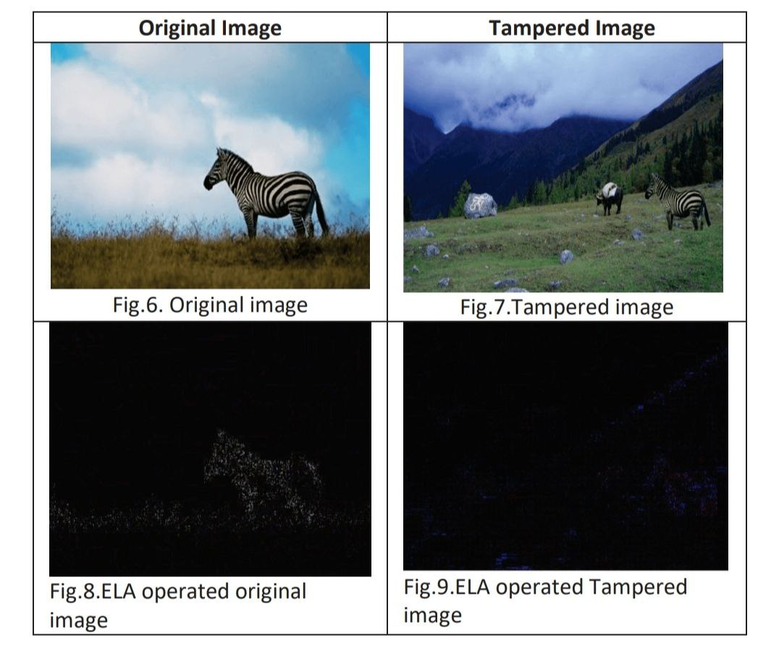
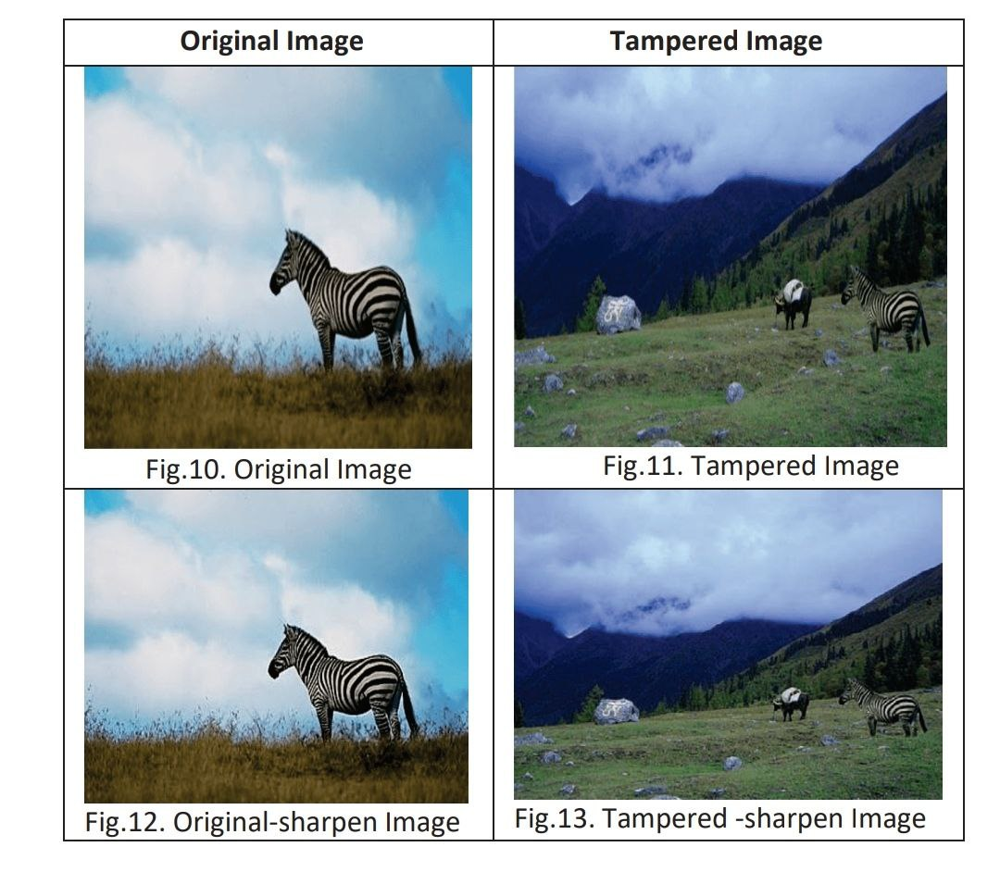
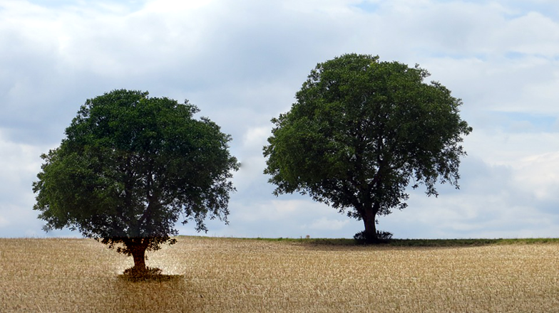
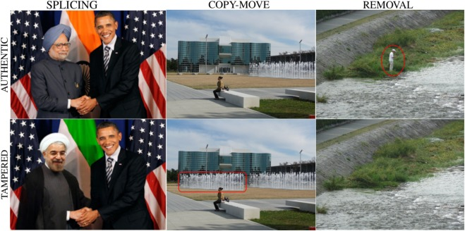
Experimental Setup / Simulation
Dataset/Images

Slide 8
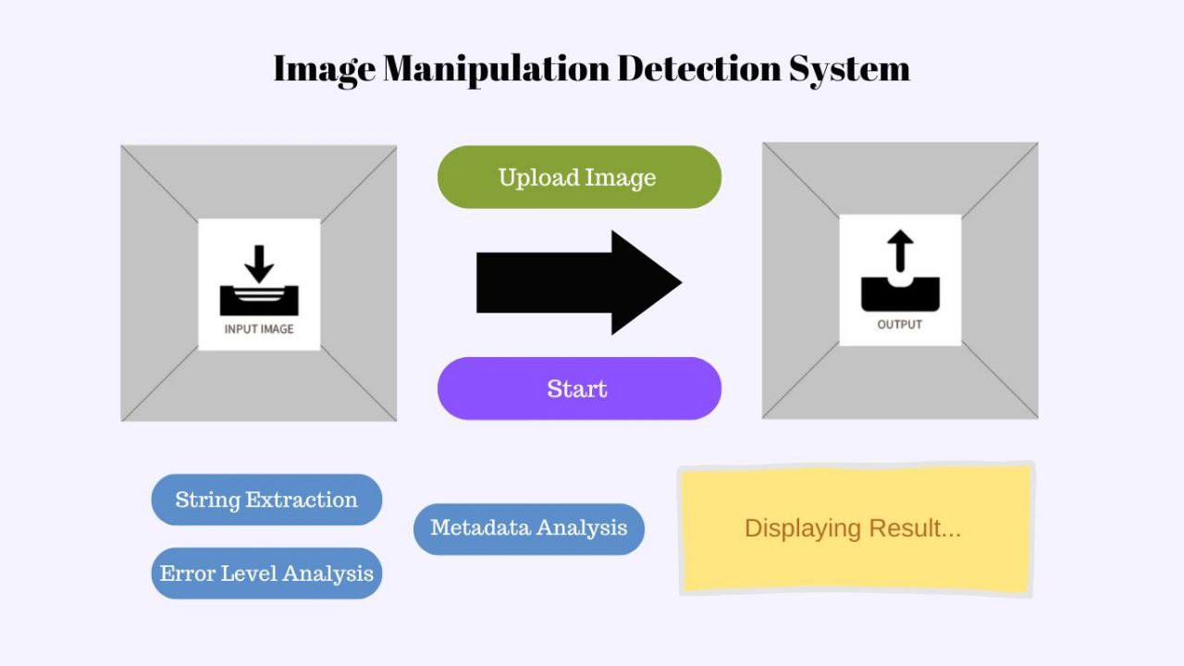
Experimental Setup / Simulation

Slide 9
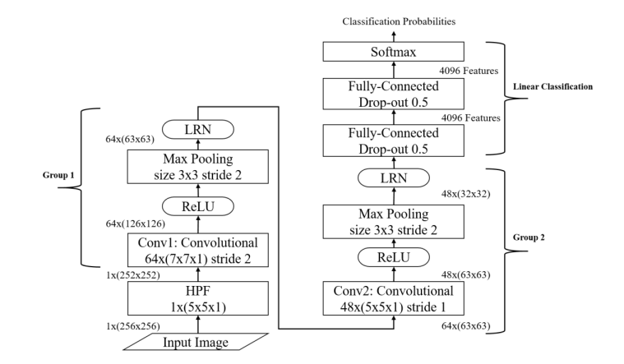
Architecture
Image Manipulation Detection Using CNN

Slide 10
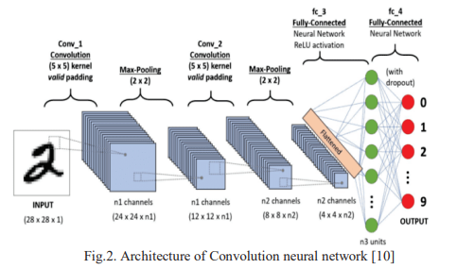
Methodology
There are two phases :
Pre-processing using CNN
Transfer Learning
CNN :
Two parts :
Feature extraction & classification.
Layers :
Input Layer
Convolutional Layer
Pooling Layer
Fully Connected Layer

Slide 11
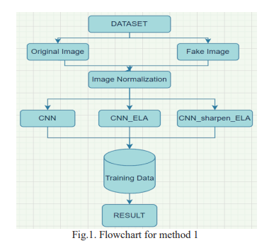
Methodology
Algorithm :
ELA (Error Level Analysis) :
Identifies the area within an image which is having significantly different compression levels
Detects modification if section of image is at different error level.
Highlights the differences in JPEG compression level
Edges :
I ) low-contrast edges should be almost as bright as high-contrast
II) high-contrast edges should look similar to each other
Textures : Similar texture should have similar coloring
Surfaces : All surfaces should have same coloring

Slide 12
Detailed Design

Slide 13
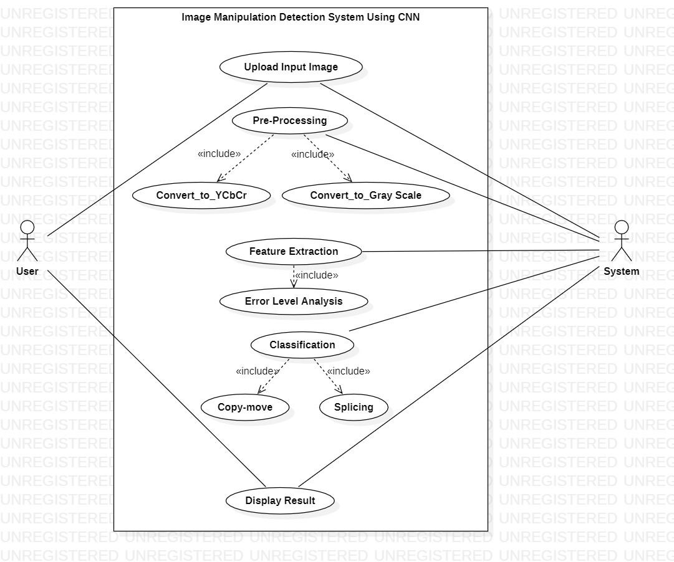
Use Case Diagram

Slide 14
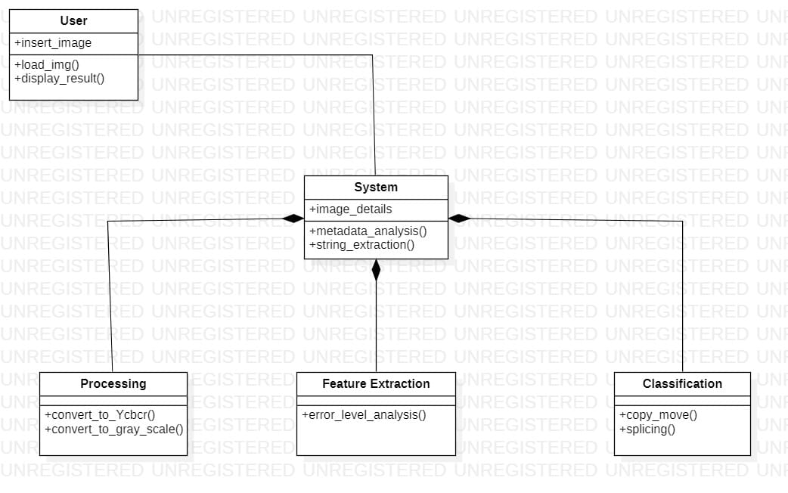
Class Diagram

Slide 15
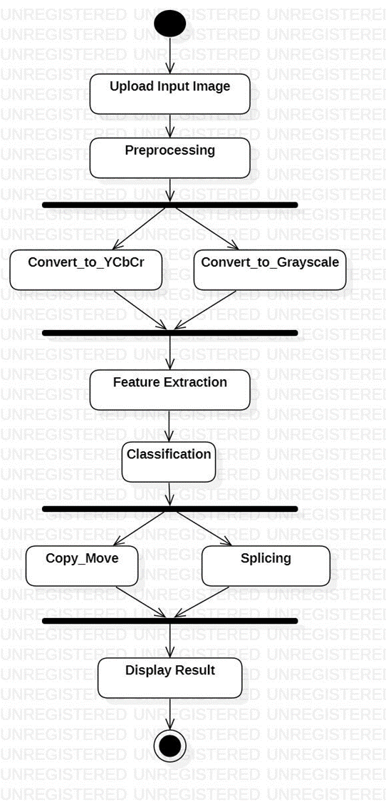
Activity Diagram

Slide 16
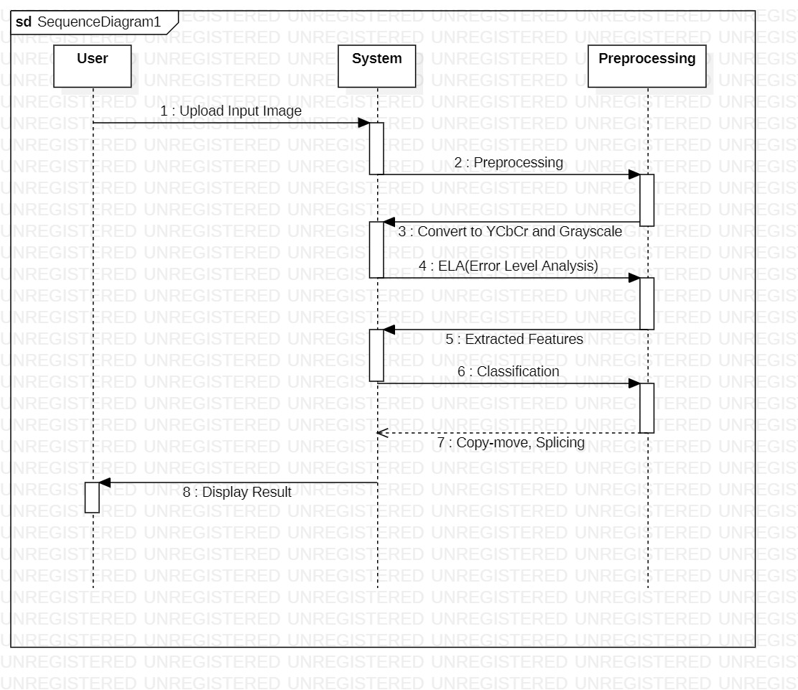
Sequence Diagram

Slide 17
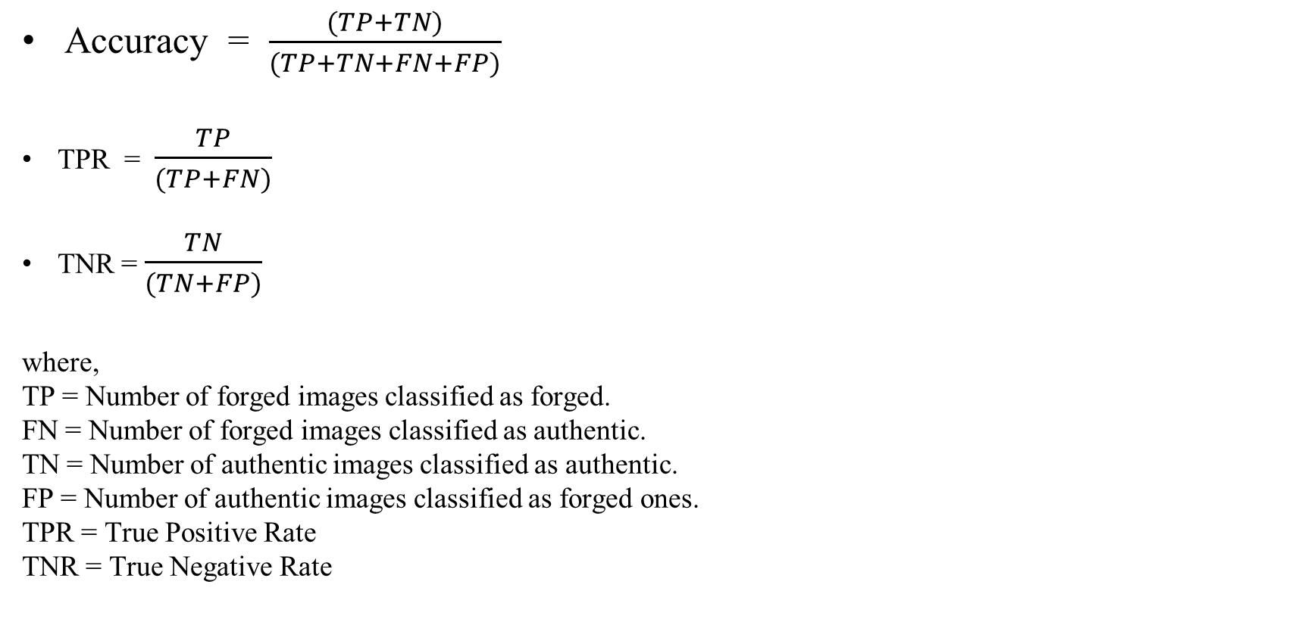
Performance Parameters
Accuracy = $\frac{(TP+TN)}{(TP+TN+FN+FP)}$
TPR = $\frac{TP}{(TP+FN)}$
TNR = $\frac{TN}{(TN+FP)}$
where,
TP = Number of forged images classified as forged.
FN = Number of forged images classified as authentic.
TN = Number of authentic images classified as authentic.
FP = Number of authentic images classified as forged ones.
TPR = True Positive Rate
TNR = True Negative Rate

Slide 18
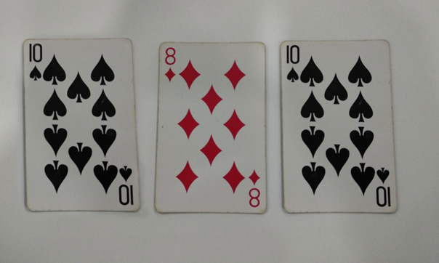
Efficiency Issues
When the image's size is tiny and has undergone multiple compression, the model finds it challenging to predict.
Less sharpen image could not give desired output.
Image with duplicate objects will also be identified as tampered /
forged image even though image is not manipulated.

Slide 19
Conclusion
As the internet advances rapidly in modern society, there are many social network services and sites which have been used for good reasons but some take the advantage of it and misuse it for negative purposes.
Digital forensics are needed to detect these illegal activities. As such there are not many techniques developed in society.
Image Manipulation Detection technique using CNN is introduced.
The model can be used to determine whether the image tampers or not and if tampered which type of tampering or manipulation is done
The manipulation of image may be of two types splicing and copy-move which will be detected and classified in this technique
The classification is done with the help of CNN and is used for detecting the tampered area.
We have used the casia v2.0 dataset for training and testing our model. Which has given 93% accuracy.

Slide 20
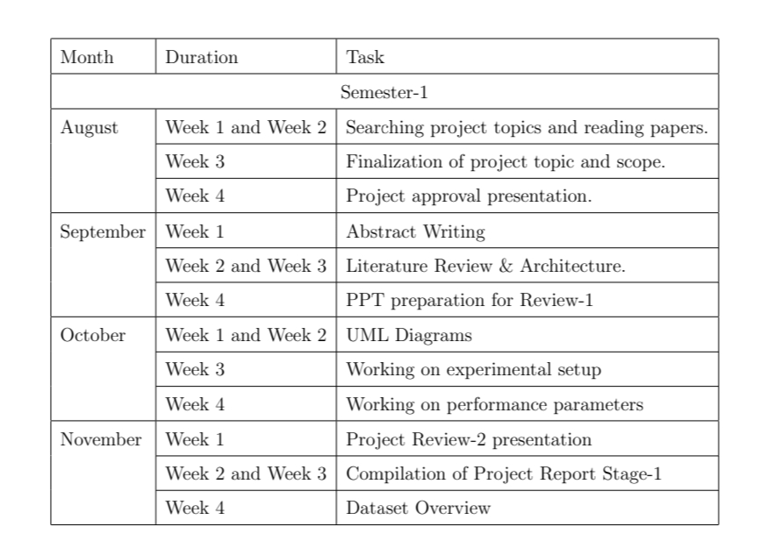
Project Planning

Slide 21
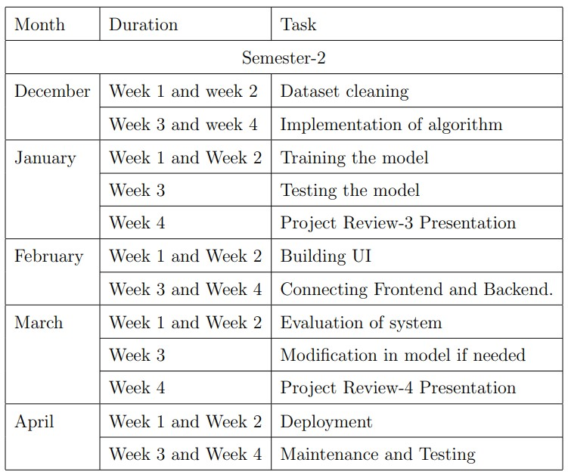
Project Planning

Slide 22
References :
A. Singh and J. Singh, ”Image forgery detection using Deep Neural Network,” 2021 8th International Conference on Signal Processing and Integrated Networks (SPIN), 2021, pp. 504-509, doi: 10.1109/SPIN52536.2021.9565953.
Dong-Hyun Kim and Hae-Yeoun Lee, ”Image Manipulation Detection using Convolutional Neural Network” ,International Journal of Applied Engineering Research ISSN 0973-4562 Volume 12, Number 21 (2017) pp. 11640-11646.
Shilpa Dua, Jyotsna Singha, HarishParthasarathy, ”Image forgery detection based on statistical features of block DCT coefficients”, Third International Conference on Computing and Network Communications (CoCoNet19)
B. Singh and D. K. Sharma, ”Image Forgery over Social Media Platforms - A Deep Learning Approach for its Detection and Localization,” 2021 8th International Conference on Computing for Sustainable Global Development (INDIACom), 2021, pp. 705-709.
I. T. Ahmed, B. T. Hammad and N. Jamil, ”Image Copy-Move Forgery Detection Algorithms Based on Spatial Feature Domain,” 2021 IEEE 17th International Colloquium on Signal Processing Its Applications (CSPA), 2021, pp. 92-96, doi: 10.1109/CSPA52141.2021.9377272.

Slide 23


